Slide 1
Global illumination with many-light methods
Jaroslav Křivánek
Charles University, Prague

Slide 2
Review: Path integral formulation of light transport
Veach, 1998

Slide 3
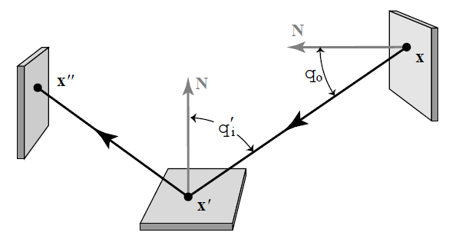
Zobrazovací rovnice v 3b formulaci

Slide 4
Měřicí rovnice v 3b formulaci
Rovnovážná radiance
(Řešení zobrazovací rovnice)
Důležitost emitovaná z x’ do x
(Značení: šipka = směr šíření světla, nikoli důležitosti)
x’ ... na senzoru
x … na ploše scnény

Slide 5
Transport světla jako integrál přes prostor světelných cest
Cíl: místo integrální rovnice chceme formulovat transport světla jako integrál přes cesty:
Příspěvek cesty x k hodnotě pixelu
(contribution function)
Míra na množině světelných cest
Hodnota (“měření“) j-tého pixelu
Prostor všech světelných cest
Spojujících zdroj světla s pixelem j

Slide 6
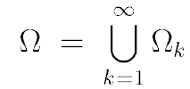
Obor integrování
… množina cest délky k
množina cest všech možných délek

Slide 7
Míra na prostoru cest
Diferenciální míra pro cesty délky k
Tj. násobný integrál přes plochu scény, pro každý
vrchol cesty jedna „fajfka“

Slide 8
Aplikace integrálu přes cesty
Odhad integrálu pomocí klasických Monte Carlo metod:
Jak definovat a spočítat hustotu na prostoru cest?

Slide 9
Hustota p-nosti na prostoru cest
Hustota pravděpodobnosti cesty
Sdružená hustota pozic vrcholů cesty:
Součin podmíněných hustot pro jednotlivé vrcholy (vzhledem k plošné míře)

Slide 10
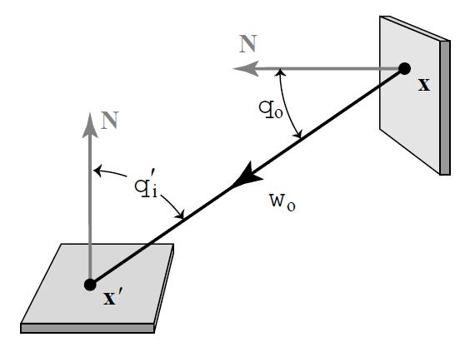
Hustota pro vzrokování směru
Hustota p-nosti není invariantní vůči míře
Nutno konvertovat z dω na dA

Slide 11
Instant radiosity
Keller, 1997

Slide 12
Instant radiosity
http://dl.acm.org/citation.cfm?id=258769
The “original” many-light method
Probably the first GPU-based GI algorithm
SIGGRAPH 1997

Slide 13
Instant radiosity
Approximate indirect illumination by
Virtual Point Lights (VPLs)
Generate VPLs
Render with VPLs

Slide 14
VPL Tracing
Exactly the same as photon tracing
see e.g. CG III slides: http://cgg.mff.cuni.cz/~jaroslav/teaching/2011-pg3/slides/krivanek-10-npgr010-2011-pm.pptx

Slide 15
VPL Tracing
Pick a light source
Pick an initial point an direction
Trace particle
Create a VPL (photon) at every non-specular surface intersection

Slide 16
VPL
Diffuse VPL
Position, surface normal
“Power”
Glossy VPL
Position, surface normal
“Power”
BRDF parameters at VPL position
Incident direction

Slide 17
VPL contribution
VPL power
VPL emission distribution
(BRDF lobe at p – for a diffuse VPL can be folded into Φ)
Geometry term
p
Visibility
ω_{o}
x

Slide 18
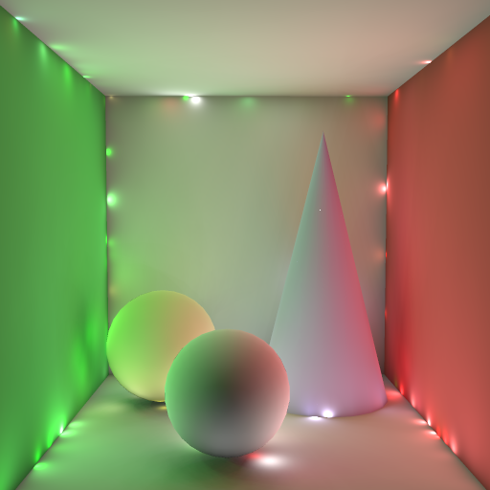
Effect of variance
“correlated noise”

Slide 19
Getting rid of variance – Clamping
VPL power
VPL emission distribution
(BRDF lobe at p – for a diffuse VPL can be folded into Φ)
min{ c,
}
Geometry term
p
Visibility
ω_{o}
x

Slide 20
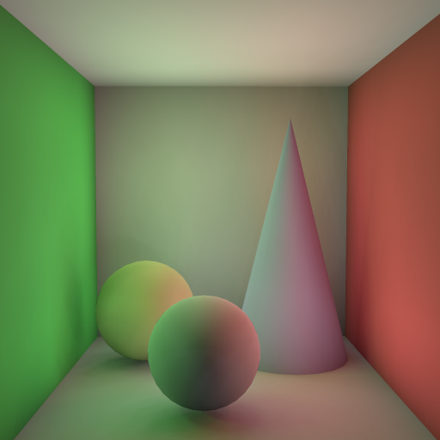
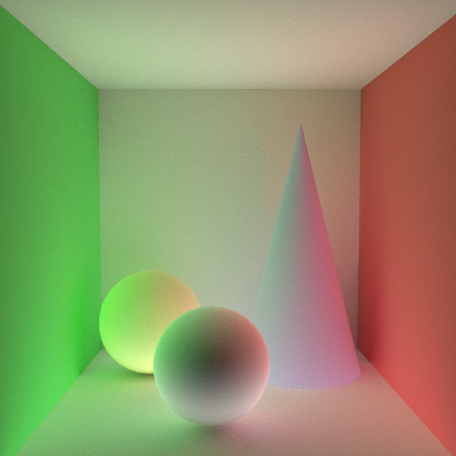
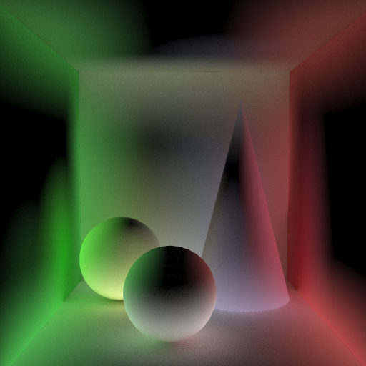
Effect of clamping
1000 VPLs - no clamping
1000 VPLs - clamping
reference (path tracing)
missing energy

Slide 21
IR as a path-sampling technique
VPLs = light sub-paths
VPL contributions = sub-path connections
Path splitting at VPL position

Slide 22
Instant radiosity
Works great in diffuse scenes
100s of VPLs sufficient for ok-ish images
Basis of many real-time GI algorithms
Efficiency: accumulate VPL contribs using GPU (shadow mapping for visibility)

Slide 23
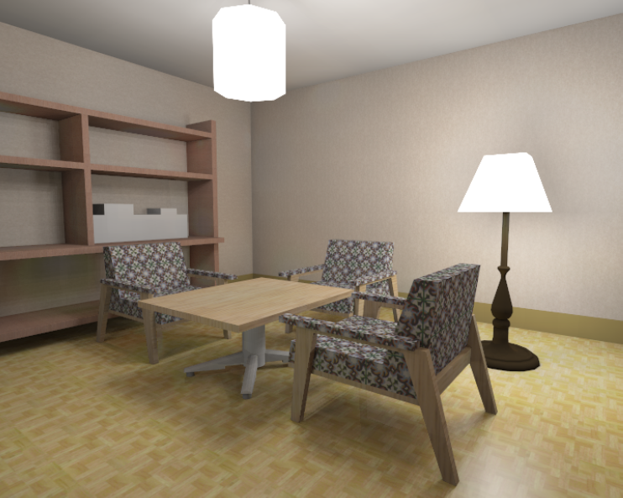
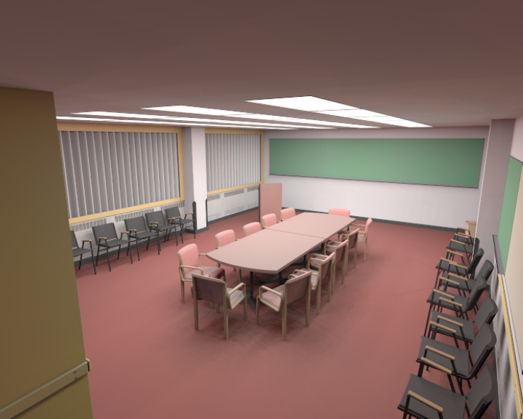
IR: Results from the original paper
128 VPLs

Slide 24
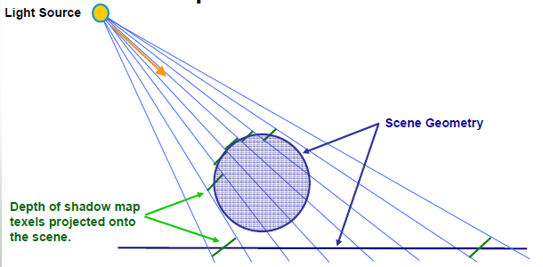
Digression: Shadow Mapping

Slide 25
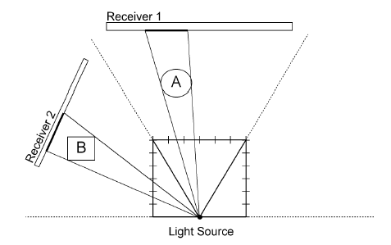
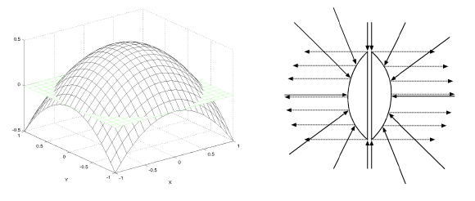
Digression: Shadow Mapping
Shadow maps for 180 degree lights (VPLs)
Option 1: Hemicube shadow maps.
slow (render scene 5 times)
Option 2: Paraboloid mapping
Images: Brabec et al. 2002

Slide 26
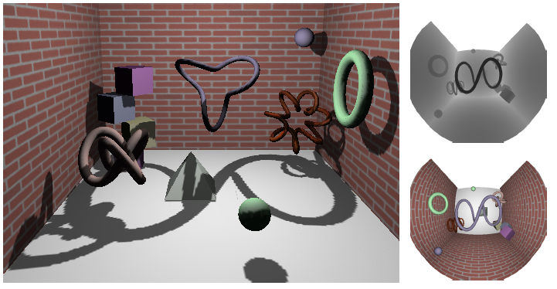
Digression: Shadow Mapping
Paraboloid shadow mapping
Images: Brabec et al. 2002

Slide 27
Real-time GI with instant radiosity

Slide 28
Real-time GI with Instant radiosity
Reflective shadow maps [Dachsbacher and Stamminger 05]
Fast VPL generation
Incremental Instant Radiosity [Laine et al. 07]
Only a few new VPLs per frame
Imperfect Shadow Maps [Ritschel et al. 08]
Faster shadow map rendering

Slide 29
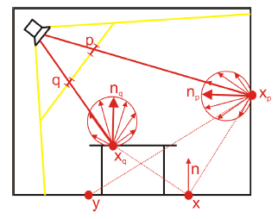
Reflective shadow maps
http://cg.ibds.kit.edu/publikationen.php
Key idea: Interpret shadow map pixels as VPLs
I3D 2005

Slide 30
Reflective shadow maps
Key idea: Interpret shadow map pixels as VPLs

Slide 31
Reflective shadow maps
Key idea: Interpret shadow map pixels as VPLs
Problem
Too many SM pixels -> too many VPLs
Solution
Subsample the RSM
Different samples for each pixel

Slide 32
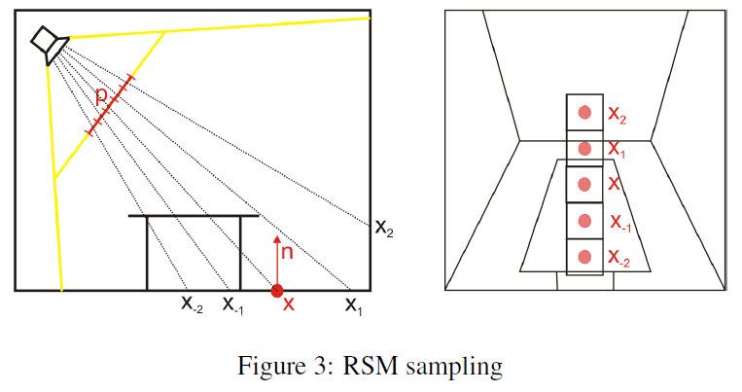
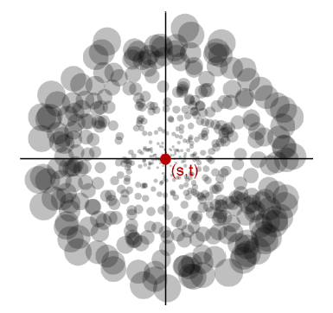
Reflective shadow maps
Consider x at which we compute indirect illum.
Project x onto the RSM
Select RSM pixels close to the projection
Sampling pattern w/ sample weights

Slide 33
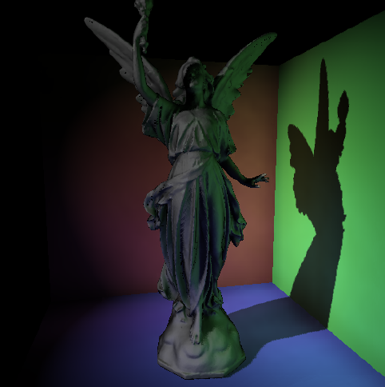
Reflective shadow maps
Only one-bounce indirect illumination
Further optimizations
no visibility testing in indirect calculation
screen-space subsampling
Results
5fps for 400 VPLs on an GeForce Quadro FX4000

Slide 34
Incremental Instant Radiosity
http://www.tml.tkk.fi/~samuli/
Key idea: reuse VPLs from previous frames
EGSR 2007

Slide 35
VPL Reuse
Reuse VPLs from previous frame
Generate as few new VPLs as possible
Stay within budget, e.g. 4-8 new VPLs/frame
+ Benefit: Can reuse shadow maps!
! Disclaimer: Scene needs to be static (only light positions can change)
Slide courtesy Samuli Laine

Slide 36
How To Reuse VPLs
Every frame, do the following:
Delete invalid VPLs
Reproject existing VPLs to a 2D domain according to the new light source position
Delete more VPLs if the budget says so
Create new VPLs
Compute VPL intensities
Slide courtesy Samuli Laine

Slide 37
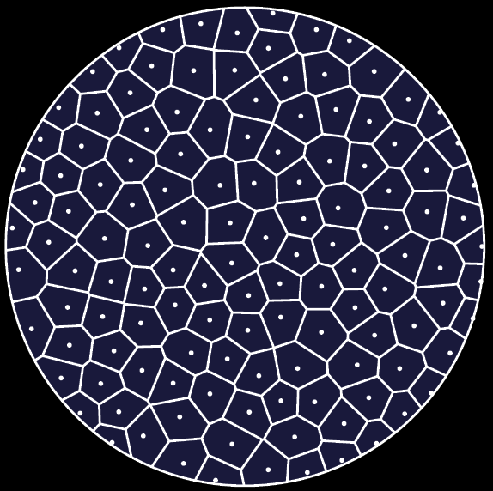
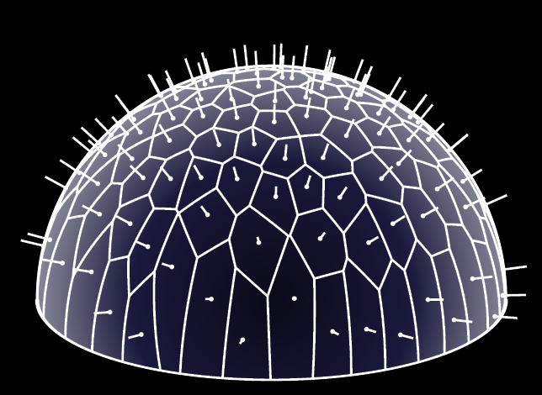
2D Domain for VPLs
Let’s concentrate on 180º cosine-falloff spot lights for now
Nusselt analog
Uniform distribution in unit disc
= Cosine-weighted directional distribution
Slide courtesy Samuli Laine

Slide 38
Reprojecting VPLs
So we have VPLs from previous frame
Discard ones behind the spot light
Discard ones behind obstacles
Reproject the rest
Slide courtesy Samuli Laine

Slide 39
Spatial Data Structures
Compute Voronoi diagram and Delaunay triangulation for the VPL point set
Slide courtesy Samuli Laine

Slide 40
Deleting VPLs
Greedily choose the ”worst” VPL
= The one with shortest Delaunay edges
Slide courtesy Samuli Laine

Slide 41
Generating New VPLs
Greedily choose the ”best” spot
= The one with longest distance to existing VPLs
Slide courtesy Samuli Laine

Slide 42
Computing VPL Intensities
Since our distribution may be nonuniform, weight each VPL according to Voronoi area
Slide courtesy Samuli Laine

Slide 43
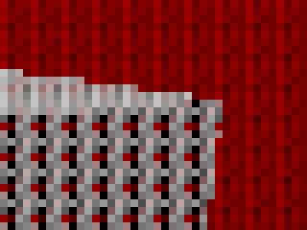
Interleaved Sampling
Reduces the number of shadow map lookups per pixel
For each pixel, use a subset of all VPLs
Apply geometry-aware filtering
Slide courtesy Samuli Laine

Slide 44
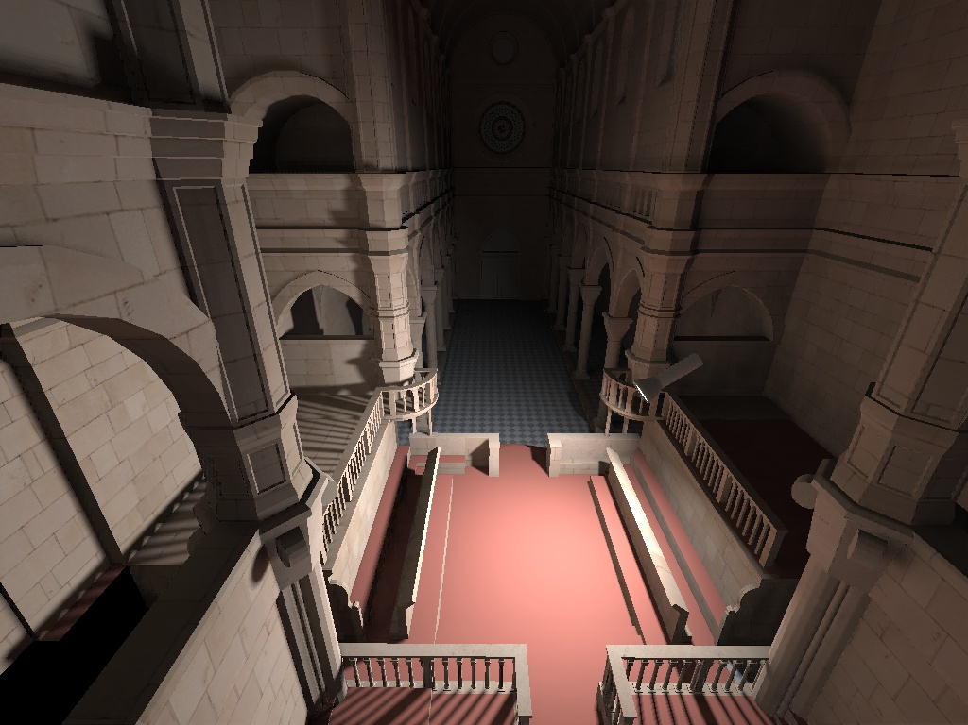
Sibenik
Triangles:
tessellated 109k
Resolution | Time (ms) | FPS
1024×7680 | 17.0 | 48.6
1600×1200 | 30.1 | 25.9

Slide 45
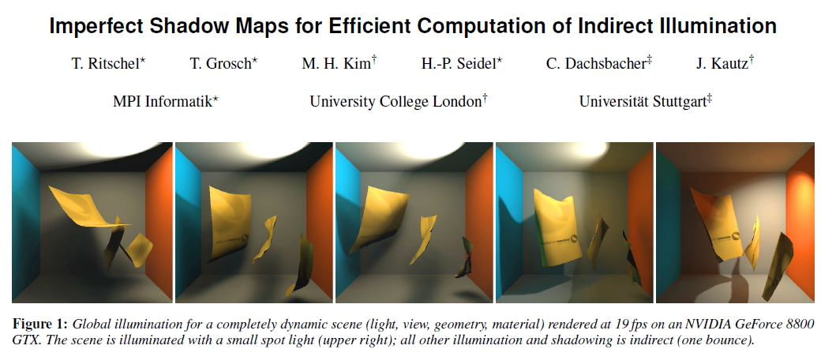
Imperfect Shadow Maps
http://www.mpi-inf.mpg.de/resources/ImperfectShadowMaps/
Key idea: Faster shadow map rendering using a point-based geometry representation

Slide 46
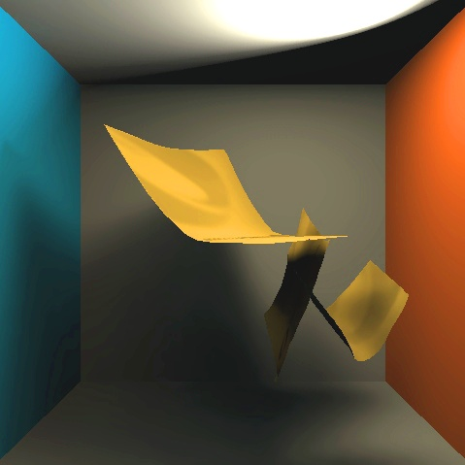
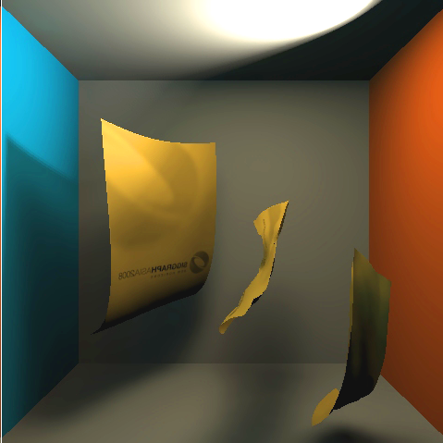
Motivation
Challenging: Dynamic indirect visibility
Frame t
Frame t+1
Direct
light
Direct
light
Indirect shadow
No indirect shadow
Slide courtesy Tobias Ritschel
Notes:
Here is a single frame from the previous animation.
The light path we are interested in, starts at the direct light (click), bounces from a surface and is than blocked by geometry (click), casting an indirect shadow.
In the next frame (click), such a path might become free (click), and the indirect shadow has turned into indirect light.

Slide 47
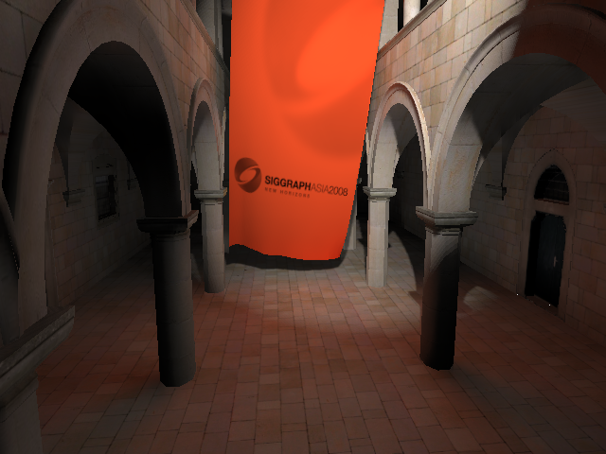
Instant Radiosity
This is 30 VPLs. You may need 1000…
Slide courtesy Tobias Ritschel
Notes:
.. that in practice, rendering a high number of depth maps is required, like in this example.

Slide 48
Instant Radiosity bottleneck
32
1024 VPLs
100k 3D model
32x32 depth map
~300M transforms
100x overdraw
32
Slide courtesy Tobias Ritschel
Notes:
In fact, this shadow map generation is the bottleneck:
Assuming we use 1024 VPLs and a 100k triangle 3d-model.
First, vertex processing requires to do 300M vertex transforms when drawing all triangles into all shadow maps.
Second, drawing 100k tris into a 1k texel depth map is a hundertfold overdraw.
Let‘s find something better …

Slide 49
Imperfect shadow maps
Observations: Low quality (imperfect) depth maps sufficient for many faint VPLs that form smooth lighting
Contribution: Efficient generation of low quality depth maps
Main steps (detailed next)
VPL generation
Point-based depth maps
Pull-push to fill holes
Shading
Slide courtesy Tobias Ritschel
Notes:
What we propose as a solution is based on the observation, that low quality depth maps are sufficient.
This is, because the individual contribution of every VPL is only small.
Also indirect lighting varies smoothly in most scenes.
Our contribution is to allow imperfection when creating a depth maps that allow for a much more efficient generation.
Our algorithm consists of 4 steps:
VPL generation,
Point-based depth map generation
A pull-push operation to fill holes from point rendering
Shading
I will detail all four steps now.

Slide 50
Step 2: Point-based depth maps
Classic
Imperfect
Imperfect
Smaller points
Less points
Slide courtesy Tobias Ritschel
Notes:
Recall, that our goal is to generate as many depth maps as possible, all of them individually very coarse, say 32x32 pixels.
Using classic depth maps for this, takes around 500 ms for the Sponza scene that our methods runs at 11 fps.
We will do his by simplification.
We will draw a low number of points instead of a large number of tris.

Slide 51
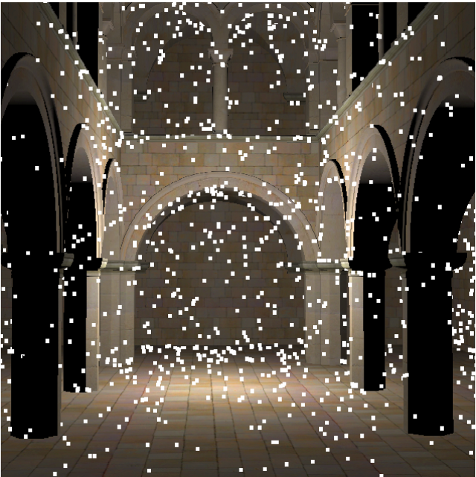
Step 2: Point-based depth maps
Pre-process: Distribute points on surface
~8k points for every VPL
Different set for every VPLs
VPL / Depth map
Slide courtesy Tobias Ritschel
Notes:
At startup, we distribute the points we will draw into the depth map over the mesh surface.
Each VPL has it’s own set of points; typically, we use 8k points per VPL.
We use a different set for every VPL.
The image to the right, shows a single VPL and it’s point set.

Slide 52
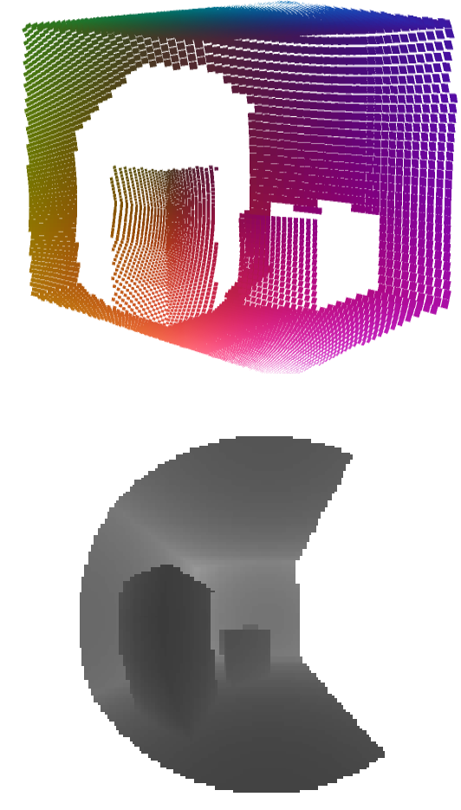
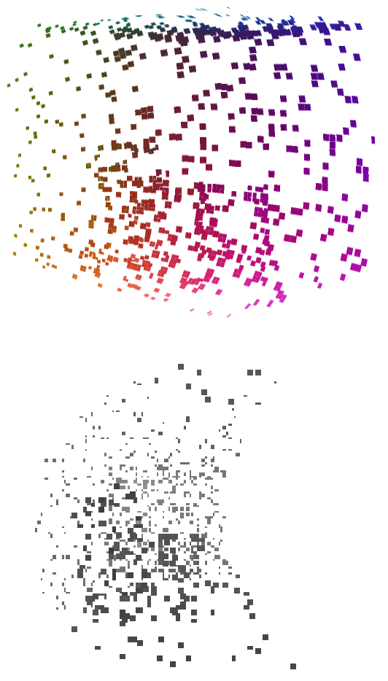
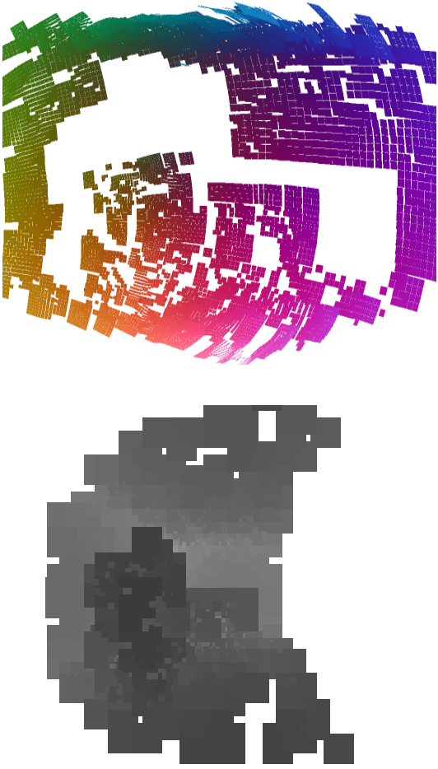
Step 3: Pull-Push
Depth maps from points have holes
3D
2D
Classic
Without pull-push
With pull-push
Slide courtesy Tobias Ritschel
Notes:
While this is a classic depth map, drawing a low number of points leads to holes, such as in this example (click).
We fill those holes using a pull-push step, similar to Grossman/Dally, to fill holes.
To this end, we build a pyramid of depth values, where we average only valid depth values in a pull step.
In the subsequent push step, every undefined pixel a every level, is replaced by the average of the defined pixels.

Slide 53
Step 3: Pull-Push
We fill those holes using pull-push ..
Classic
Without pull-push
With pull-push
Slide courtesy Tobias Ritschel
Notes:
Here we show the imperfect shadow of an individual VPL.
A depth map without pull-push will have light leaks, that are fixed by pull-push.
However, pull-push sometimes miss-classifies depth values, and gives false positive or false negatives.
Small holes might be „real“ holes and small objects could be isolated, pixel-sized floating objects.
If such miss-classification happens, the only negative result is, that such objects will not cast shadow or let light through, which is not very important, because they are small; we have many VPLs; and such errors are uncorrelated.

Slide 54
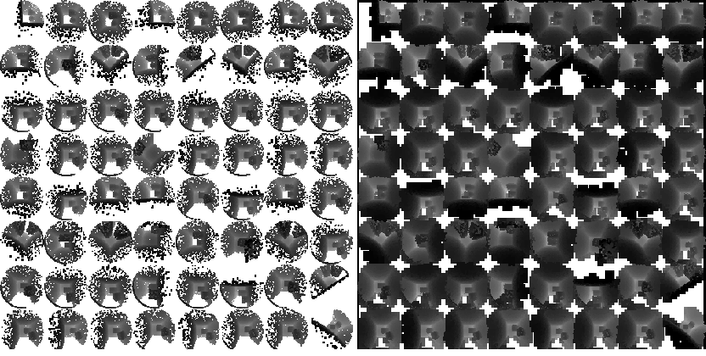
Step 3: Pull-Push
.. on all depth maps in parallel.
Without pull-push
With pull-push
Slide courtesy Tobias Ritschel
Notes:
We do this pull-push step on all depth maps in parallel.
As we work in depth map space now, we are now independent of the geometric complexity: It is irrelevant if this is an image of a Cornell Box or an XYZ dragon: it‘s just an image.

Slide 55
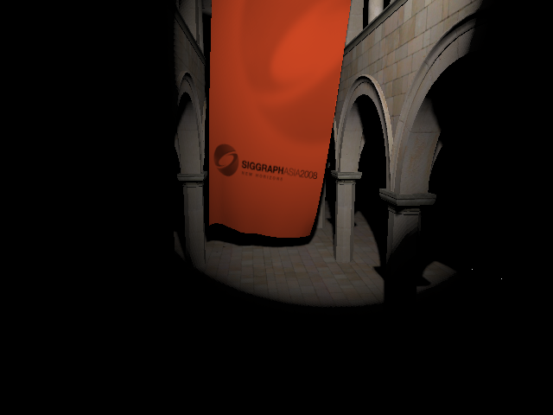
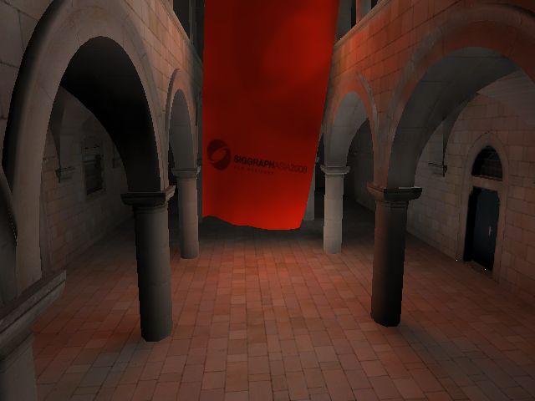
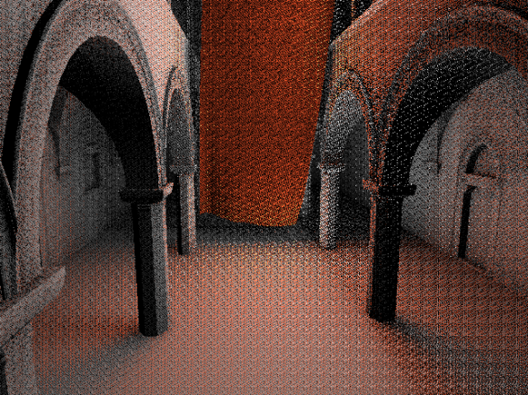
Step 4: Shading
Separate direct and indirect, both deferred
Indirect: Interleaved sampling, geometry aware blur
Direct + Indirect
Direct only
Indirect only
G-Buffer
Simple blur
Edge-aware
Slide courtesy Tobias Ritschel
Notes:
Most current methods separate direct and indirect lighting, and so do we.
We use interleaved sampling, that is we do not light every pixel with every VPL, but only, say, 16 random ones out of 256 VPLs for every pixel.
Please see the paper for details.
Doing so, will result in noise, that we blur away, using a geometry aware blur filter.

Slide 56
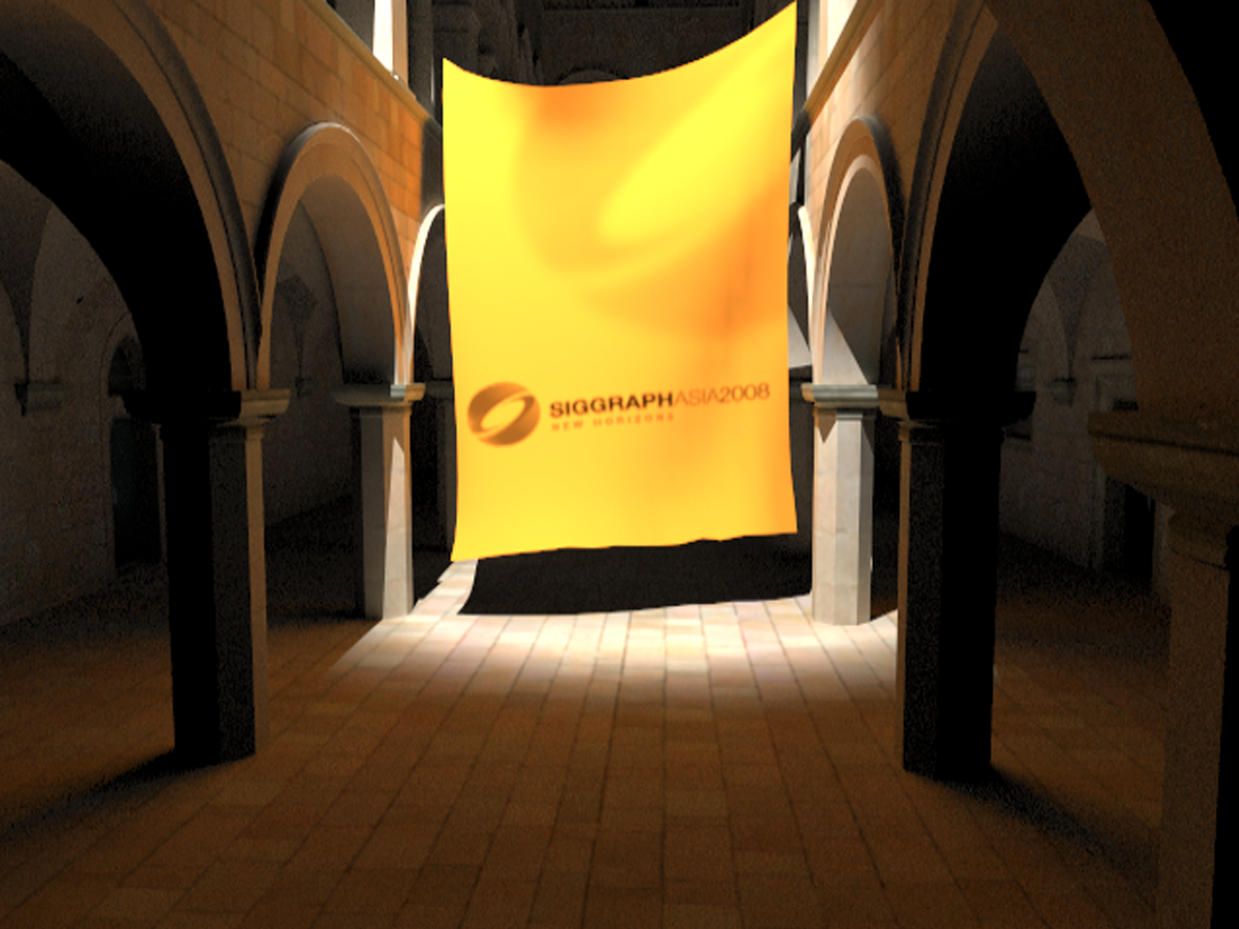
Results: Quality (PBRT, hours)
Slide courtesy Tobias Ritschel
Notes:
Our method can achieve results that are similar to a path tracer.
This is a Monte Carlo rendering from PBRT.

Slide 57
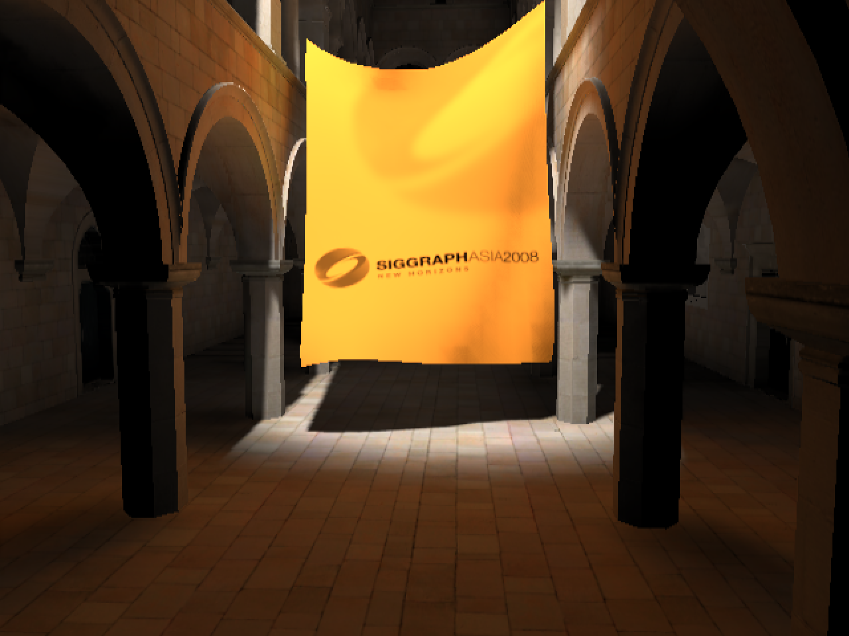
Results: Quality (Ours, 11 fps)
Slide courtesy Tobias Ritschel
Notes:
And this is our result.

Slide 58
Imperfect shadow maps: Conclusion
Doesn’t really work that great…
No contact indirect shadows
Large scenes don’t work well

